Slide 1

ATM Locator
Sprint 2 Review

Slide 2
Scrum Roles
Scrum Master : Jackson
Product Owner : John
Development team : Sam, Tim, Adrian, Cezary, Uwais, Stacy

Slide 3
Sprint 2 Goal
Our goal in Sprint 2 was to develop more user stories and produce a more user-friendly webpage as discussed in the sprint 1 review, to increase value for clients.
Our definition of done is to meet all functional requirements and close appropriate user stories. We want the webpage to be performance optimized and our API to have clear documentation.

Slide 4
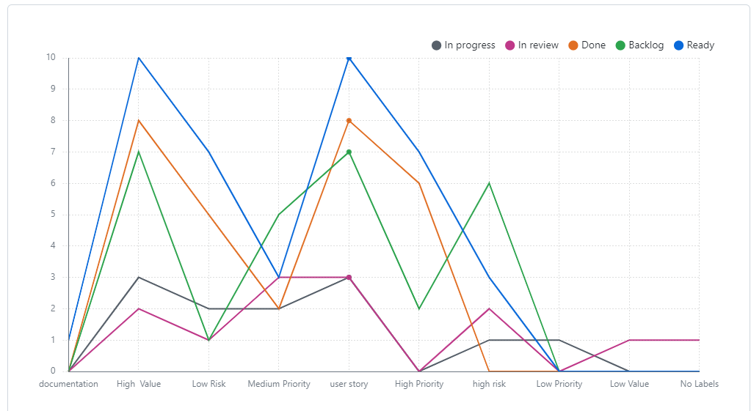
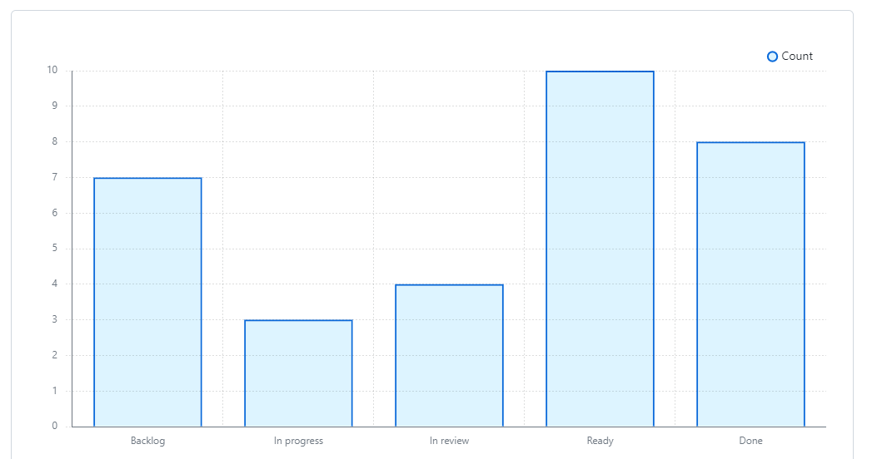
Sprint Analysis

Slide 5
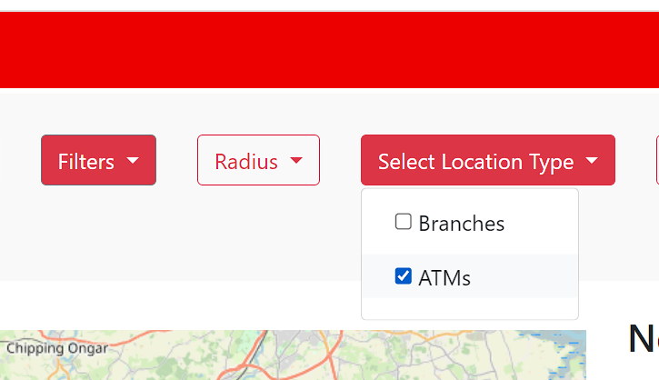
"As a Customer, I want to be able to enter a postcode, town or city name to the website to find ATMs near that location so I can use its services."
Value – high
Allows the user to manually enter a location if their current location isn't of relevance or the user isn't comfortable sharing their exact location. This makes for a more inclusive and efficient user experience

Slide 6
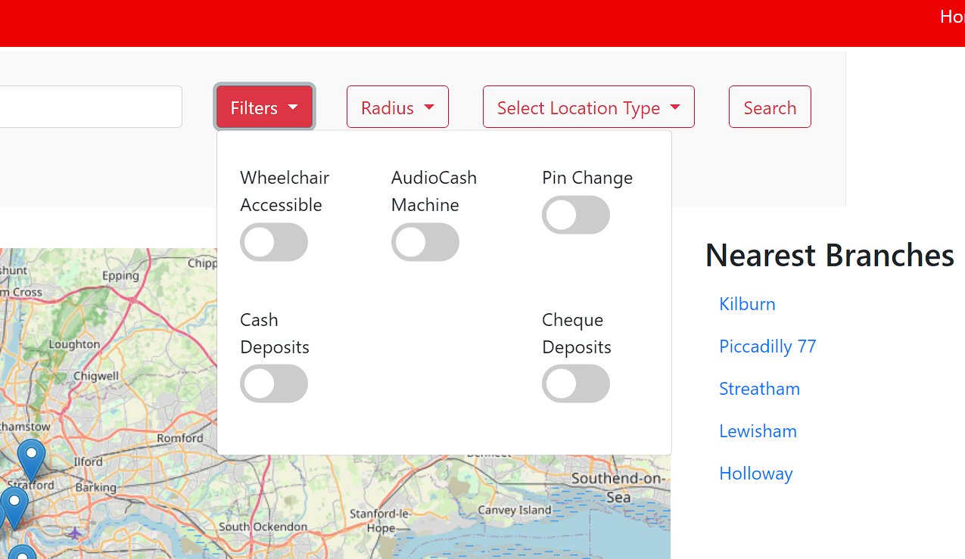
"As a Customer I want to be able to filter my searches based on specific things so I can find the one I require that meets my needs."
Value- high
Allows the customer to see ATM/branches relevant to their needs allowing for a more seamless user experience

Slide 7
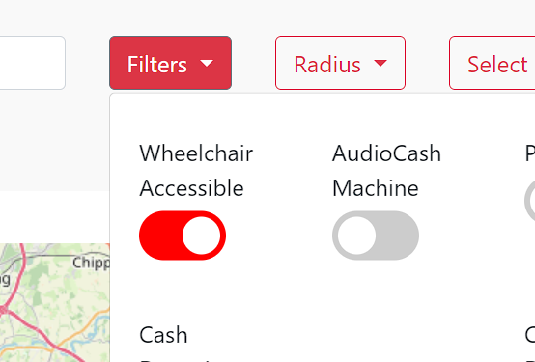
"As a Wheelchair User I want to be able to find a Santander branch with wheelchair access so I can enter the building easily."

Slide 8
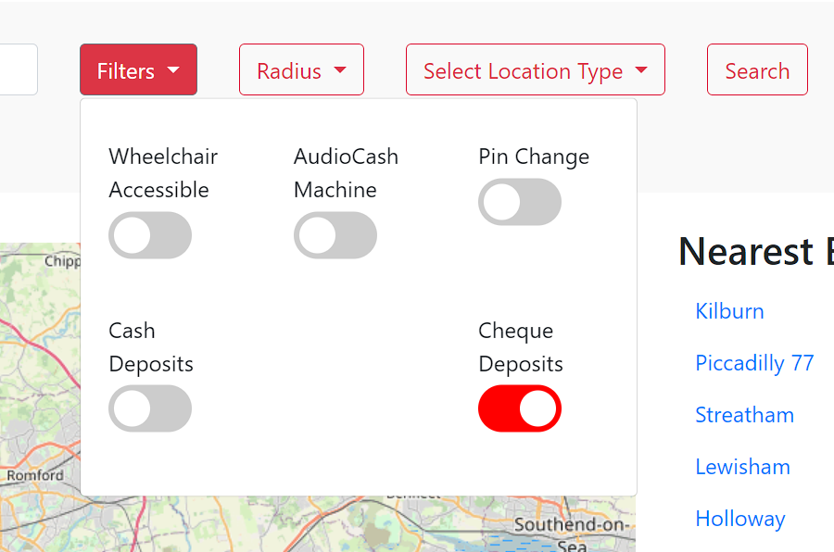
"As a Customer, I want to see the nearest ATM to me that supports cheque deposit so I can save time going into the bank."

Slide 9
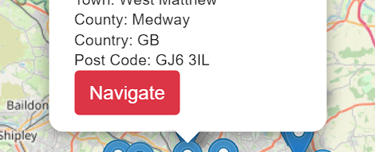
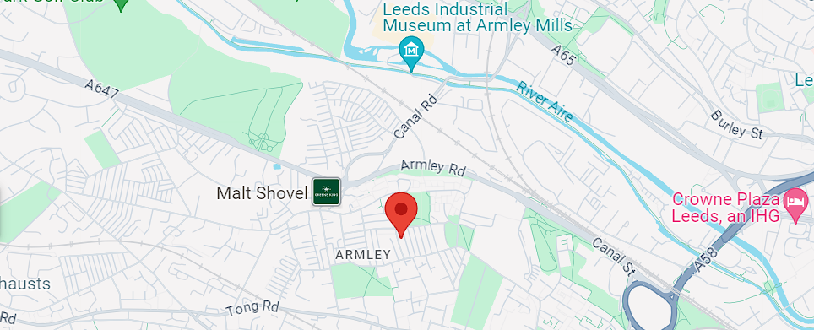
"As a user I want to be able to be taken to Google or Apple maps so I can search for ATMs on my device."
Value – medium
Allows the user to be transported to Google maps if they wish. This is of high value to mobile users as they could use it to navigate directly to ATMs/branches seamlessly with a few clicks

Slide 10
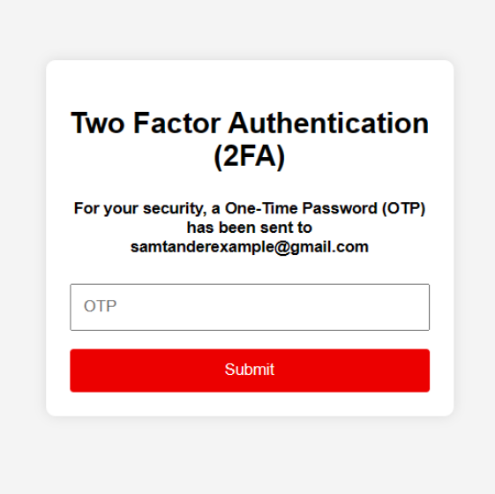
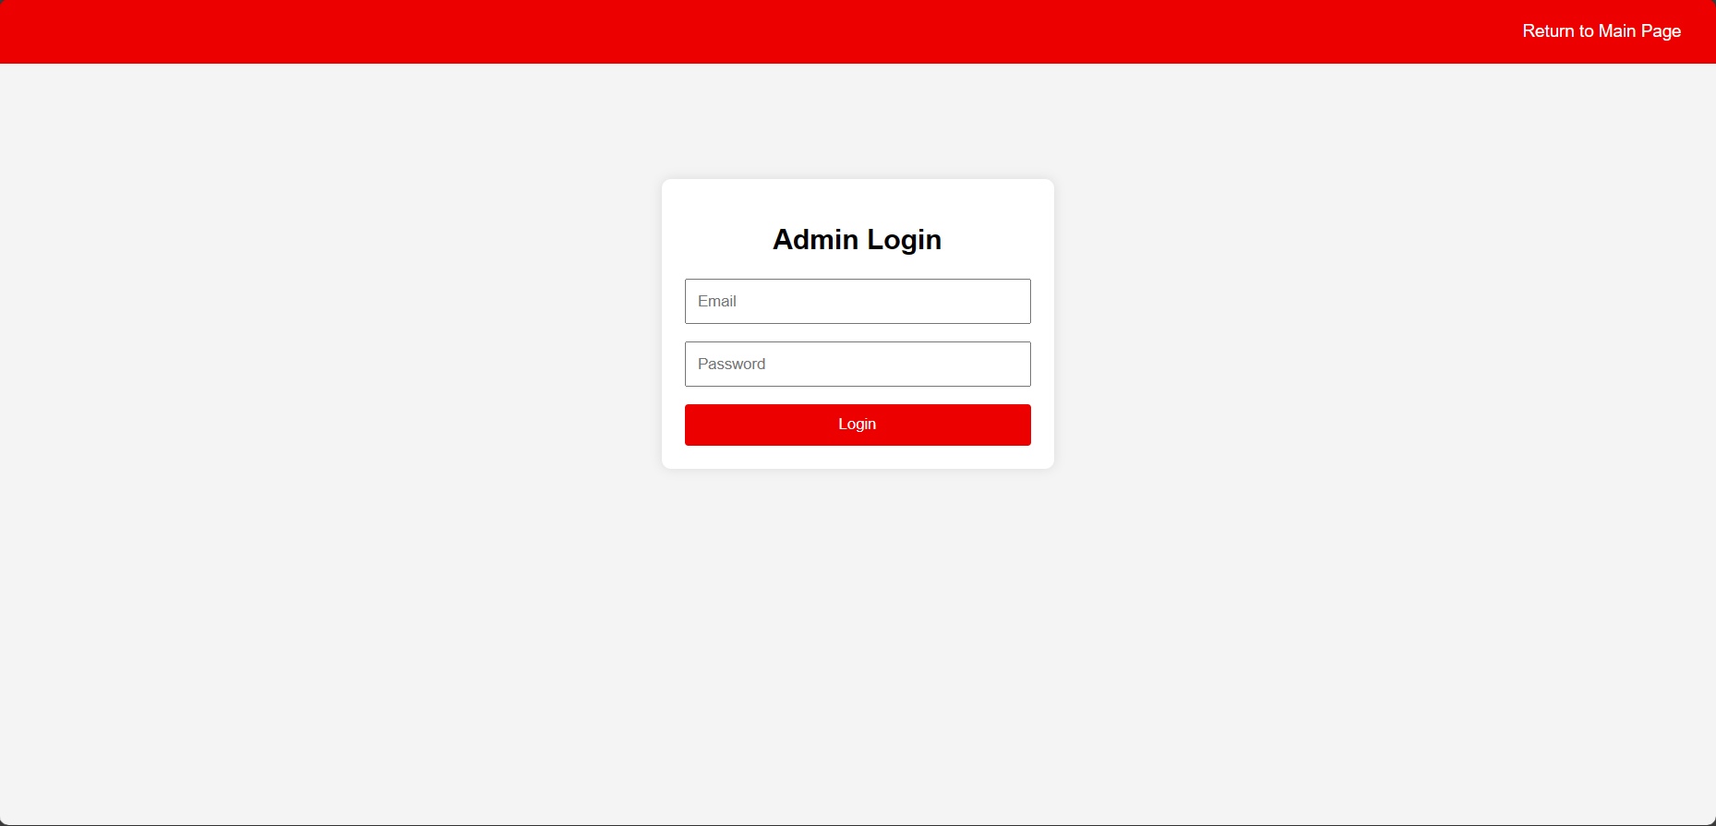
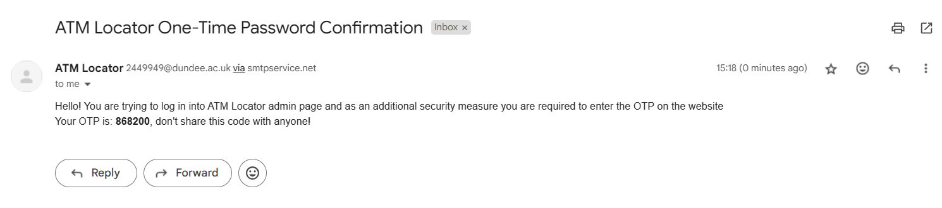
"As a company executive I want the systems to be secure so I can prevent third party access."
Value High
Adding 2FA and password hashing will make the log in process for admins more secure. This will make company executives more confident about the systems security.

Slide 11
As a bank executive I want to be able to test the database systems capabilities by adding dummy ATM location if we want to expand as a company
Value – medium
Allows bank executives to test the systems capabilities if the company wanted to add more ATM locations or potentially sell the system to bigger companies.

Slide 12
Overall Thoughts

Slide 13

Next sprint

Slide 14
Thank You

